Slide 1
San Francisco Crime Data Analysis
Jason Widjaja Djuandy, Nail Enikeev, Nassim Ali-Chaouche
Department of Applied Data Science, San Jose State University
DATA 240: Data Mining and Analytics
Dr. Taehee Jeong

Slide 2
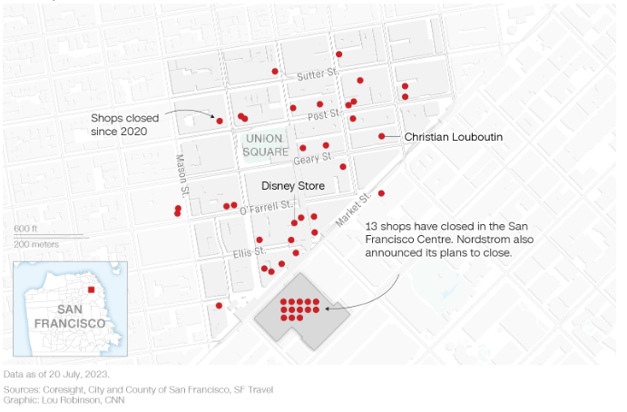
Introduction
Motivation:
According to data provided to CNN by market research firm Coresight, nearly 40 retail stores have closed in Union Square’s zip code since 2020, while dozens more have closed in the surrounding area.
Closed due to:
Difficult operating conditions
Affects both store and retail workers
Mainly due to crime in the area

Slide 3
Proposed Solution
Utilize modern data mining techniques to generate insights helpful to the relevant authorities to reduce or mitigate crime rate.
Data:
Crime Data
Economic Factor Data
Data Sources
Crime - SF OpenData 2003 - 2018 + 2018 - Present
Economic Data (Inflation) - World Bank
Median Housing Price - Zillow
Unemployment Rate - St. Louis Federal Reserve
Cleaned, Merged then Analyzed for insights

Slide 4
Data Cleaning
Crime Data
2003 - May 2018 and 2018 - 2023
Drop Unnecessary Columns
Null values checked, kept some columns with missing values to preserve information
Fix Datetime type
Removed 2018 data from 2003-May 2018 data to prevent overlap
Filter out incorrect longitude/latitude, few records dropped
Add GeoSpatial Data for Neighborhood GPS bounding boxes → For assigning crimes to certain neighborhoods based on Lat/Long
Merged the now 2003-2017 data and 2018-2023 data by ensuring the column orders and names matched
Attemped to impute some records with missing ‘Incident Category’ using a mapping from the ‘Incident Code’ column, dropped some records.

Slide 5
Data Cleaning
Inflation (World Bank)
Filter on USA, relevant Consumer Price Index (CPI) columns
Inflation Rate for a certain month was calculated as the percentage change in CPI from the same month of the previous year (Kerr & Lankford, 2023)
Inflation Rate and Date
Housing (Zillow)
Filter on San Francisco
Median Housing Price and Date
Unemployment (St. Louis FED)
Unemployment Rate and Date

Slide 6
Data Cleaning
Merged the Crime, Inflation, Housing and Unemployment rate by month and year
Dropped rows with a null inflation rate (CPI was not provided after a certain time in 2023)
Additional cleaning on the merged dataset (Ex: for the ‘Incident Category’, made the strings have consistent capitalization, e.g. “GAMBLING” -> “Gambling”)

Slide 7
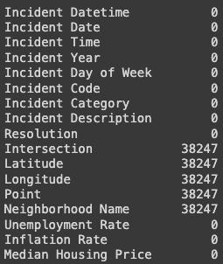
Data Cleaning
Merge Data
Main Columns of Interest:
Date and Time
Inflation Rate
Unemployment Rate
Median Housing Price
Crime Data
Category
Description
Location

Slide 8
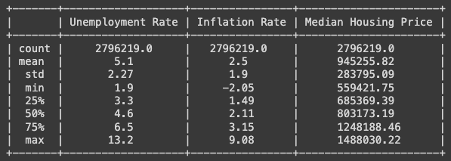
Initial Data Statistics
Date range: 1/1/03 - 3/31/23
2,796,218 rows, 18 columns
Summary Statistics for Inflation, Housing Price, and Unemployment Rate:

Slide 9
Basic Data Analysis

Slide 10
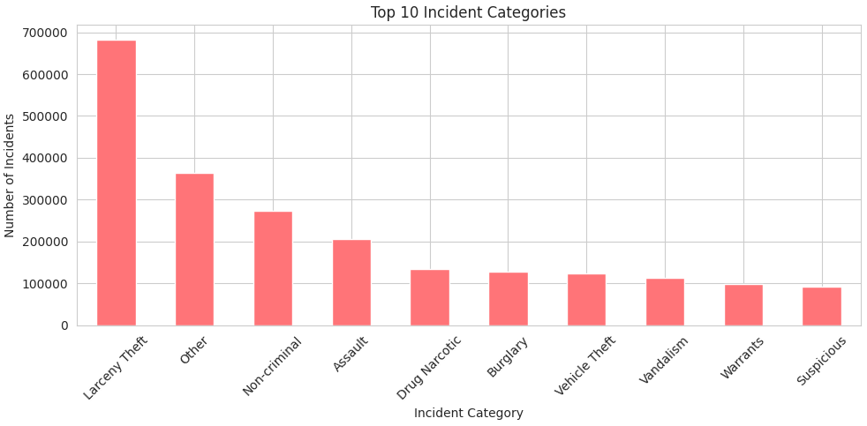

Slide 11
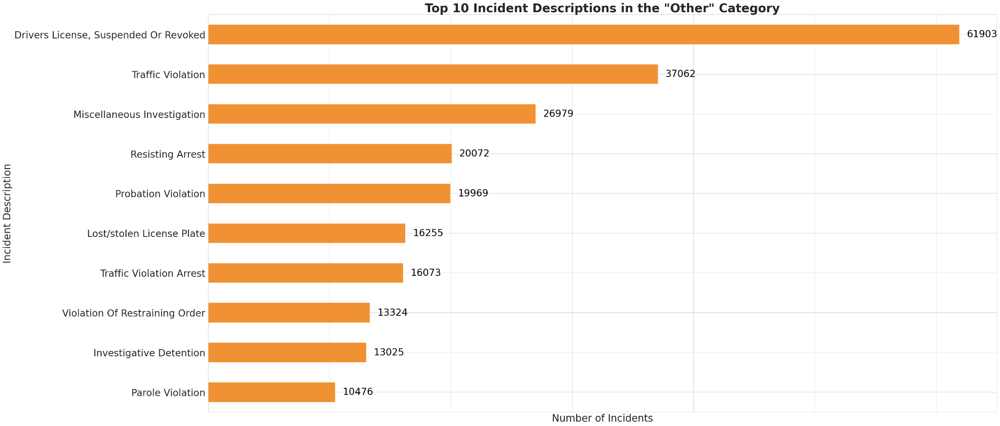

Slide 12
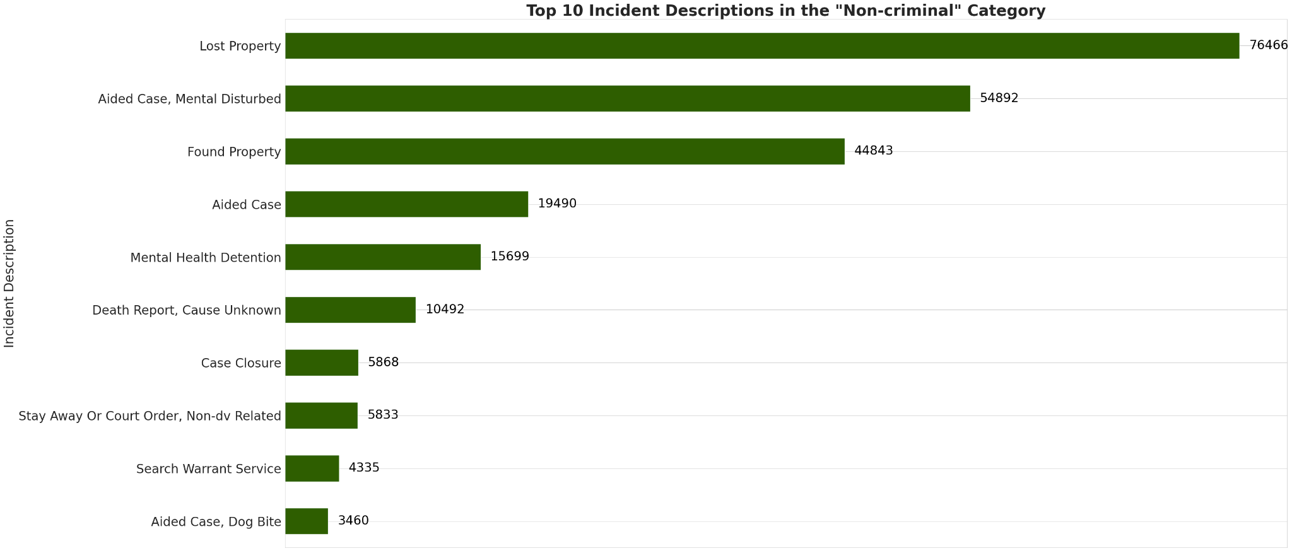

Slide 13
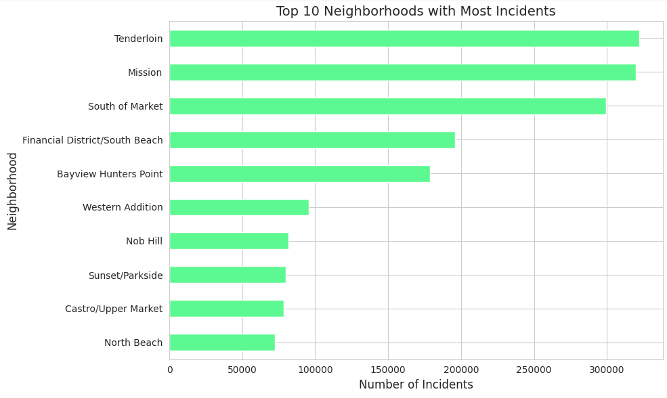

Slide 14
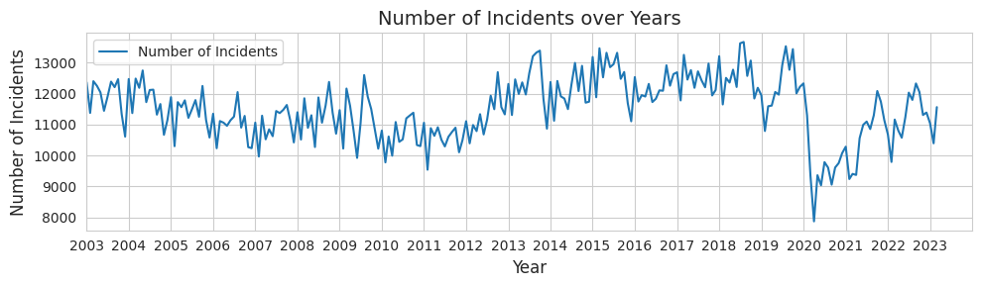

Slide 15
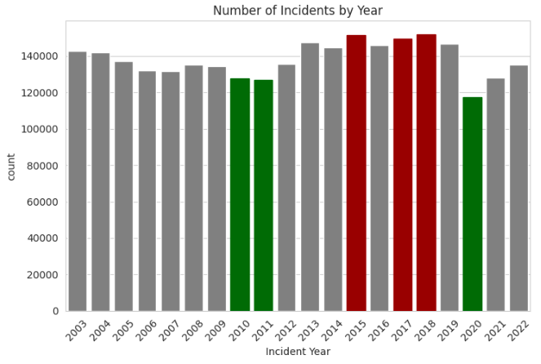
All time high in crime incidents in the years 2015, 2017, 2018. Lowest at 2010, 2011 and 2020.
Significant drop and low in 2020, most likely due to the COVID-19 pandemic

Slide 16
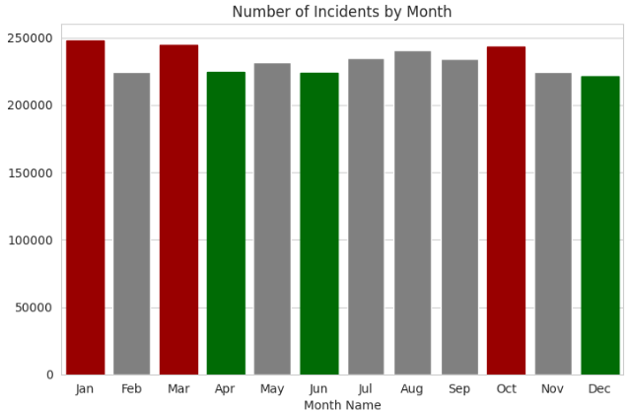
January, March, and October had the highest crime rates in San Francisco,
Spikes may be due to specific events, holidays, or seasonal factors.
April, June, and December saw the lowest crime rates, with December's drop possibly linked to the holiday season.
The high incidents suggest a pattern possibly related to weather anxiety and emotional responses to winter and autumn time.

Slide 17
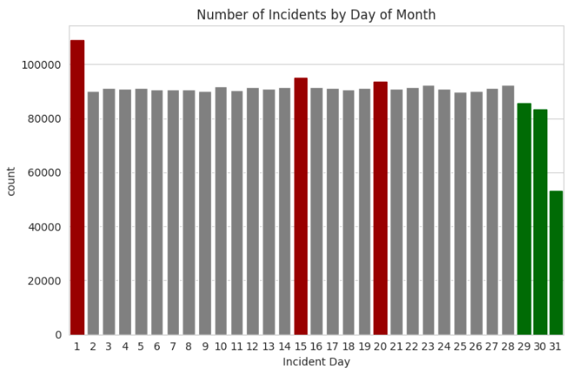
There's a sharp decline in incidents in the last three days of the month,
Spikes on the first may be linked to monthly financial pressures such as bill payments and overdue debts, which may drive individuals to commit crimes.
The noticeable drop on the 31st is attributed to fewer months having 31 days, affecting the incident count. (5 months in 2023)

Slide 18
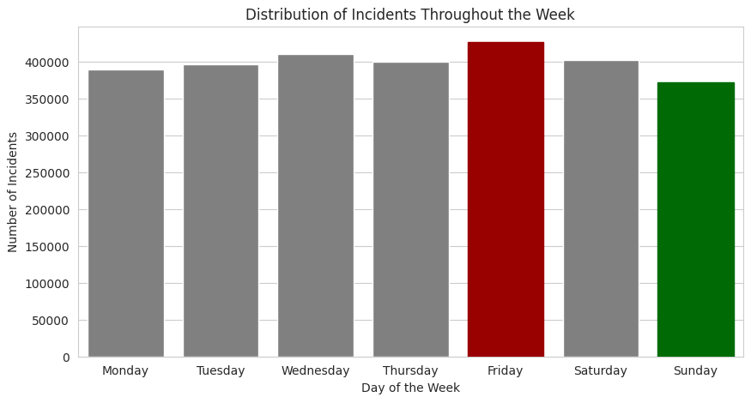
The pattern shows that Friday experiences the highest number of incidents, likely due to the culmination of the workweek and the start of the weekend, when social activities, events, and nightlife are more prevalent.
Sunday records the fewest incidents, aligning with it being a typical day of rest and reduced activity.
Overall, there is a gradual decrease in the number of incidents as the week progresses from its beginning to end.

Slide 19
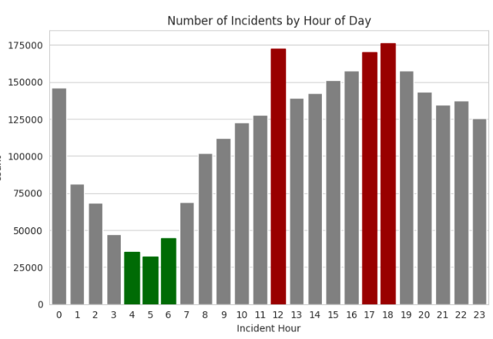
Significant increase in the probability of incidents between 12:00 and 1:00 p.m.
This could be due to employees being more vulnerable while out for lunch at restaurants and workplaces having a relaxed atmosphere, increasing the susceptibility to incidents.
Lowest number of incidents occurs between 2 a.m. and 6 a.m., explained by the generally lower levels of activity during these hours.

Slide 20
Further Analysis

Slide 21
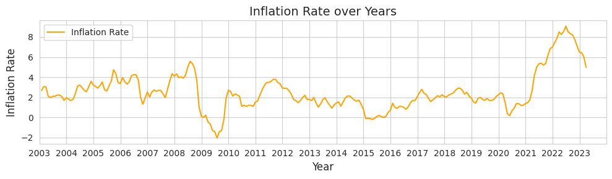
The inflation rate appears relatively stable from 2003 to around 2008.
Then, there was a notable drop due to the financial crisis and the following 2-year recession.
The following years showed stabilization and the rate was around the same till the middle of 2020.
Hypothesis: from the end of 2020 inflation rate started rapidly increasing due to the global Covid-19 pandemic event.
Hypothesis: Massive limitations in the supply chain led to market shrinking and forced the government to apply money injection into the economy, which led to the highest inflation in the 20-year period.

Slide 22
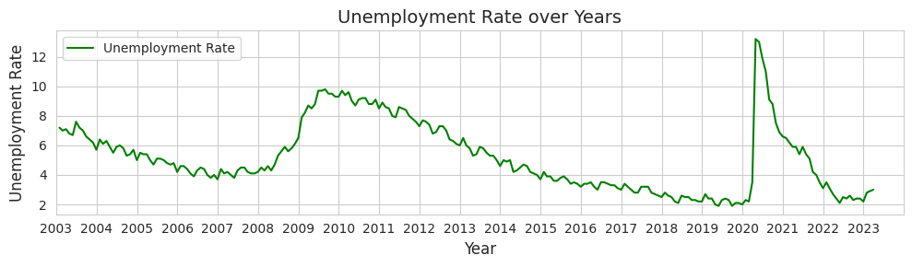
There is a clear noticeable cyclic pattern.
In the recent cycle since 2015 rate has been stable with minor fluctuations generally maintaining a negative trend.
Decline after mid of 2009 reflects recovery from the financial crisis. The spike in 2020 is a consequence of the global Covid-19 pandemic event.
Hypothesis: people had to change their work behavior and lifestyle. Many people while adapting to stressful circumstances had to change their jobs, re-educate themselves, and learn new skills to find a new job.
Hypothesis: as a result of such social activity unemployment rate showed a declining trend and with the end of the pandemic it returned to the lowest levels in 2022-2023.

Slide 23
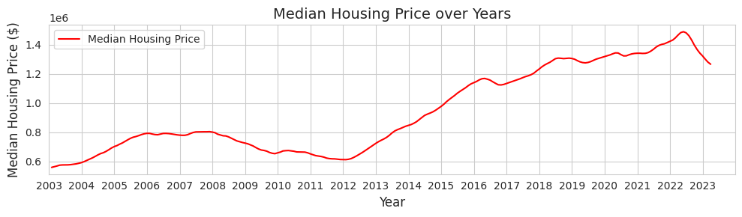
The median housing price was showing a positive trend with the peak in 2008.
The 2008 financial crisis caused damage and led to a re-evaluation of the market.
In connection with this house prices started to show a negative trend till 2012.
In the following 8 years during the economic recovery, the inflation was stabilizing and the unemployment rate was declining, which led to economic growth.
Hypothesis: buyer confidence was returned and as a cumulative effect, housing prices increased.

Slide 24
Overlay Metrics
Problem:
Cannot overlay different graphs due to different metrics used for:
Inflation Rate (%)
Unemployment Rate (%)
Incidents (Count)
Median Housing Price ($)
Solution:
Normalize the data such that the graphs can be overlapped against each other to see a sense of change and possible visual correlation.
Normalize to values between 0 - 1
Overlay different charts

Slide 25
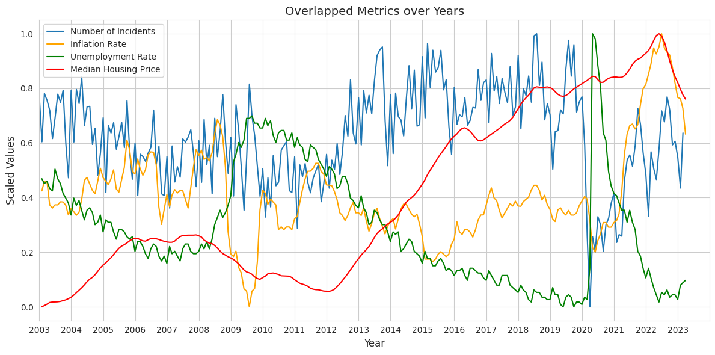
From 2010 to 2022, the data shows that periods of economic growth, as indicated by rising housing prices and a falling unemployment rate, paralleled with increase in crime rates.

Slide 26
Hypothesis: the 2008 economic crisis caused a significant downturn, affecting jobs, savings, and housing prices, with a notable impact on crime rates.

Slide 27
Post-crisis, economic recovery was evident, with crime rates initially decreasing but then peaking around 2013-2014.
The COVID-19 pandemic in 2020 led to a drastic rise in unemployment and a drop in crime rates due to reduced social activity and economic lockdowns. Government interventions temporarily stabilized the economy, but resulted in high inflation by mid-2022.
The analysis suggests that prosperity alone doesn't reduce crime; factors like social activity, urban development, and policing are also influential.
Lockdowns were found to reduce crime rates, and high housing prices may increase social anxiety and crime.

Slide 28
Hypothesis: the COVID-19 pandemic in 2020 led to a drastic rise in unemployment and a drop in crime rates due to reduced social activity and lockdowns. Government interventions temporarily stabilized the economy, but resulted in high inflation by mid-2022.
The analysis suggests that prosperity alone doesn't reduce crime; factors like social activity, urban development, and policing are also influential.
Lockdowns were found to reduce crime rates, and high housing prices may increase social anxiety and crime.

Slide 29

Insights
Hypothesis: High housing prices may increase social anxiety and crime.
Housing prices keep going up in non-crises times
Hypothesis: Prosperity, along with the growth of social inequality, increase the crime rates.
Lockdowns were found to reduce crime rates.
Other factors like social activity, urban development, and policing are also influential.

Slide 30
Location Based Analysis

Slide 32
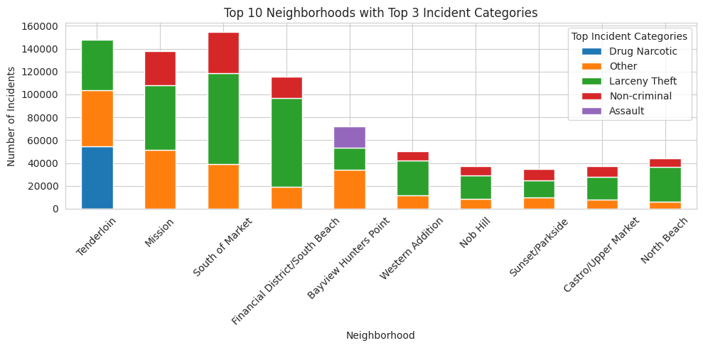

Slide 34
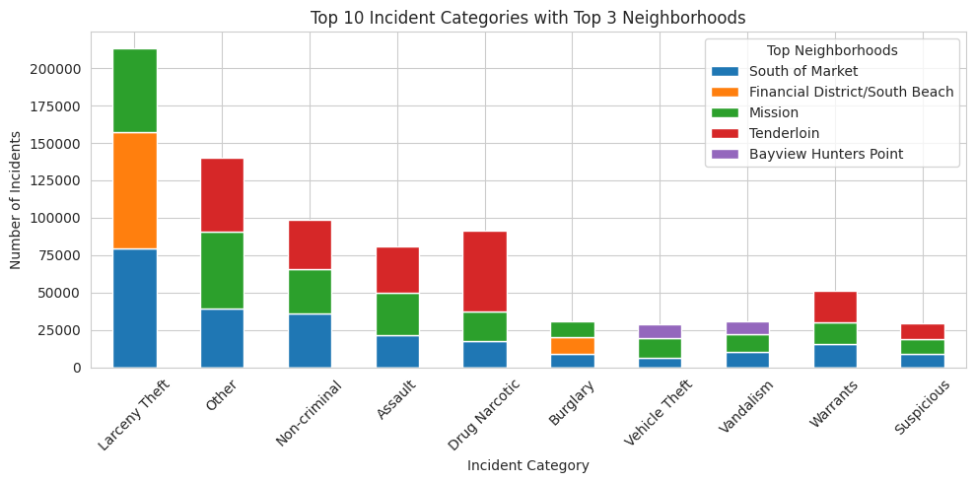

Slide 35
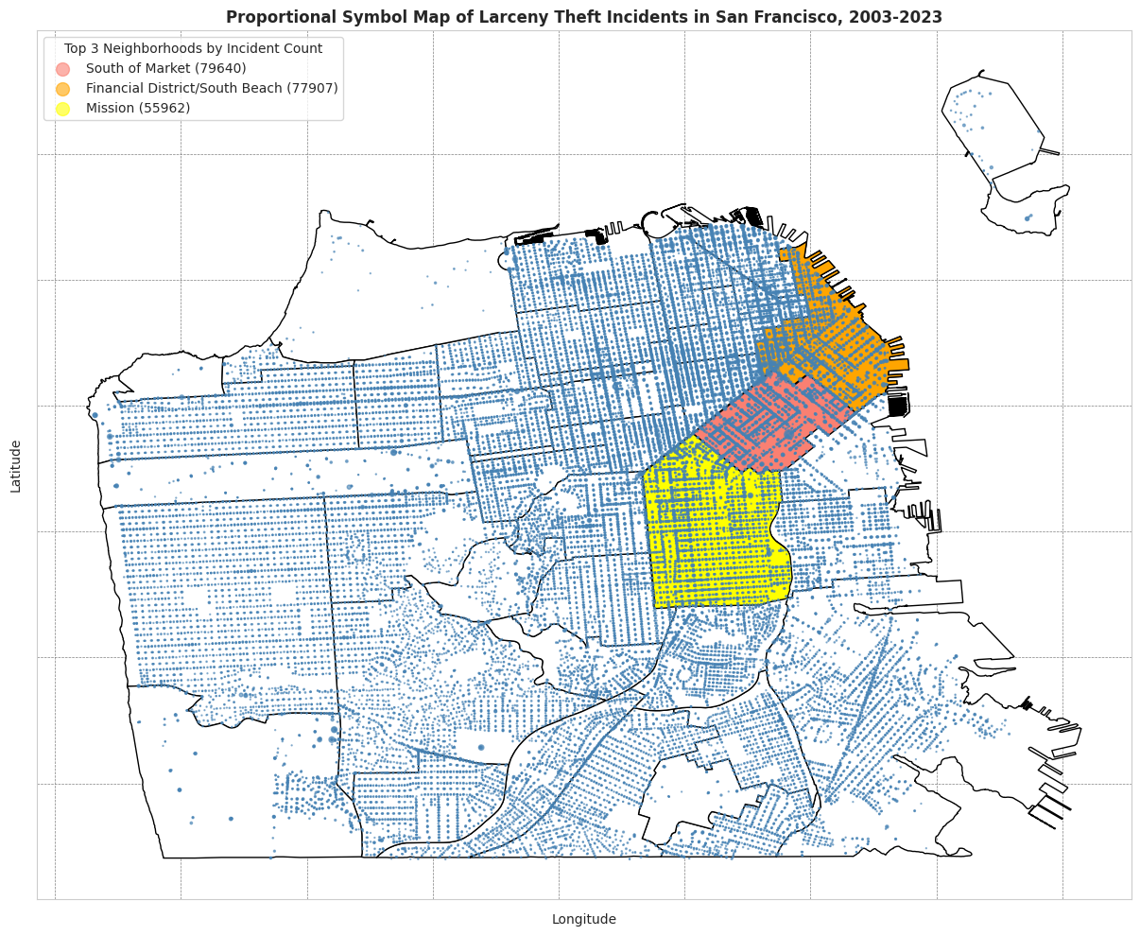

Slide 36
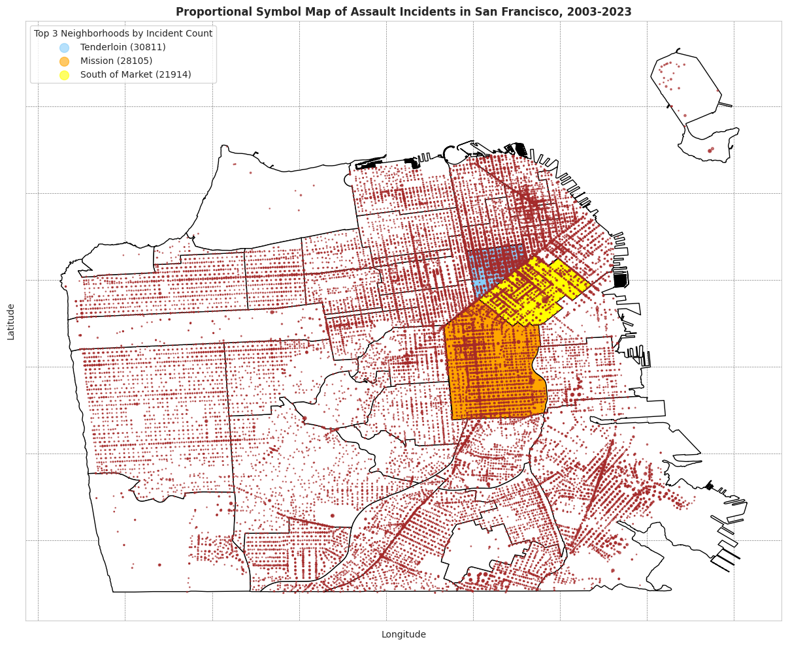

Slide 37
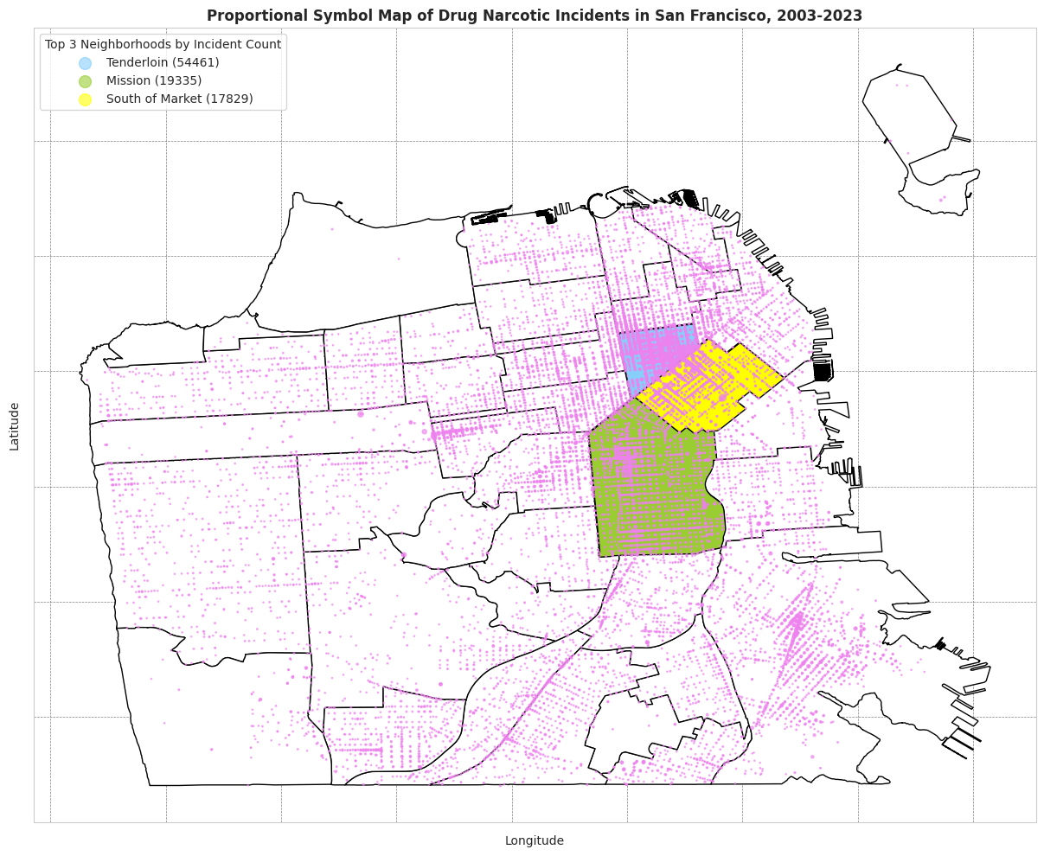

Slide 38
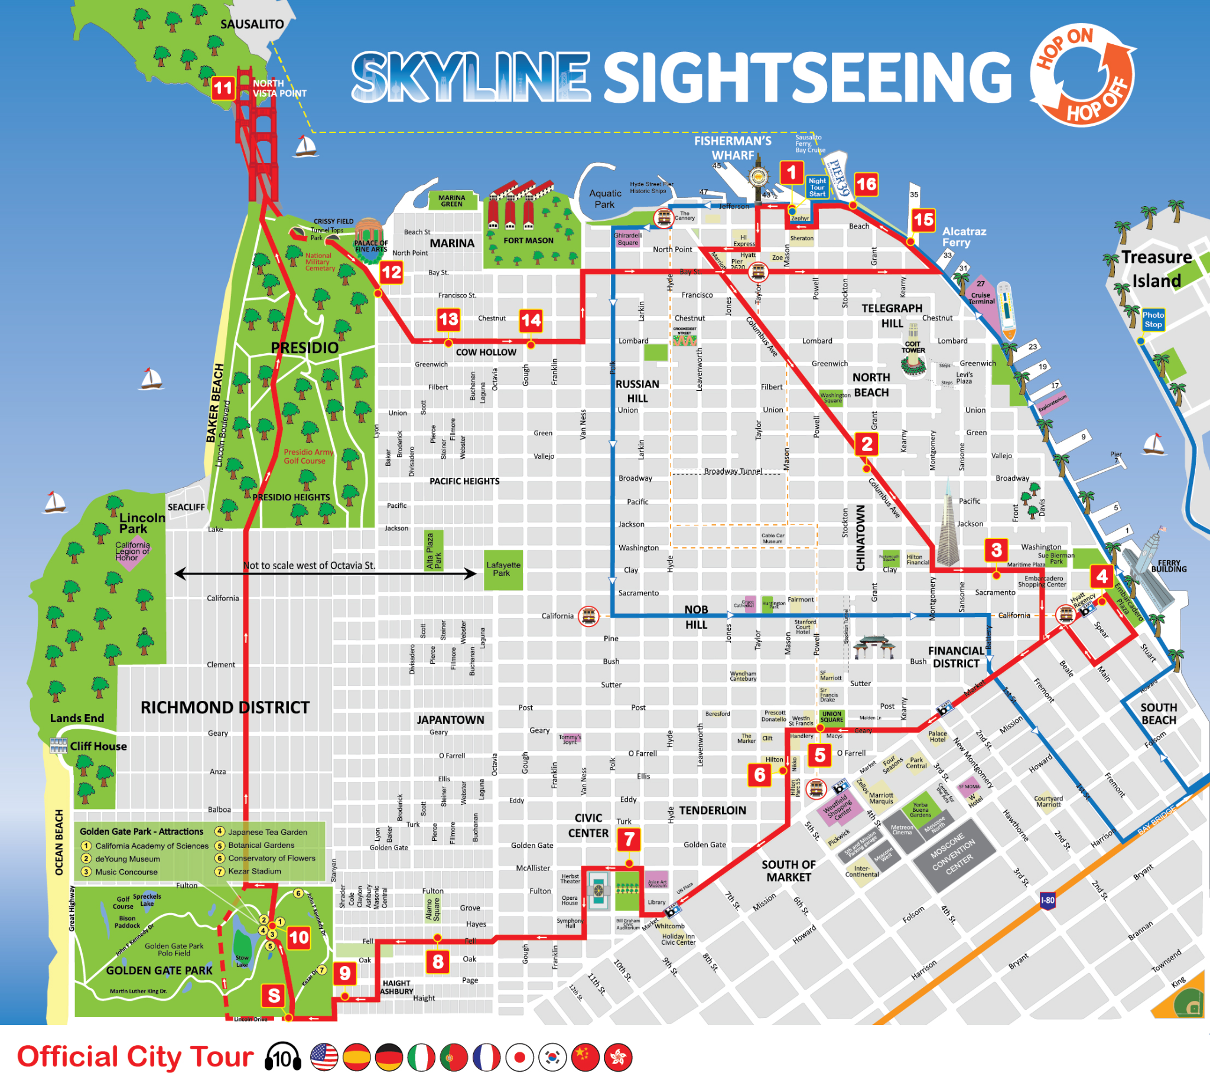
Incidents coincide with local tourist spots due to higher traffic of people in the area.
Especially in Union Square (Tenderloin/SoMA District
Image Reference:
https://www.sightseeingworld.com/en/san-francisco-tour-map

Slide 39
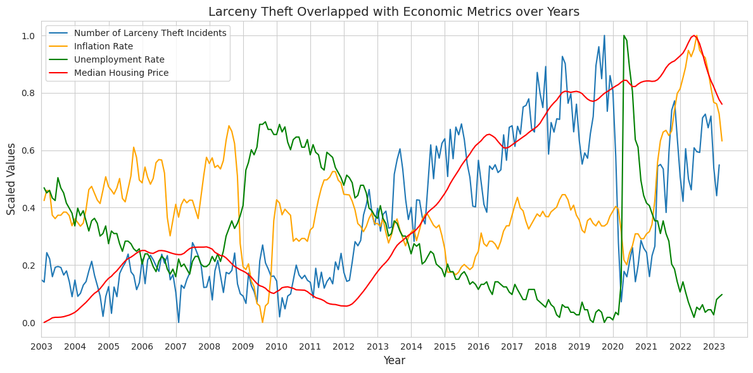
Hypothesis: Larceny Theft trend follows the Median Housing Price pattern => an increase in prices (ex., housing prices) provokes individuals to steal.

Slide 40
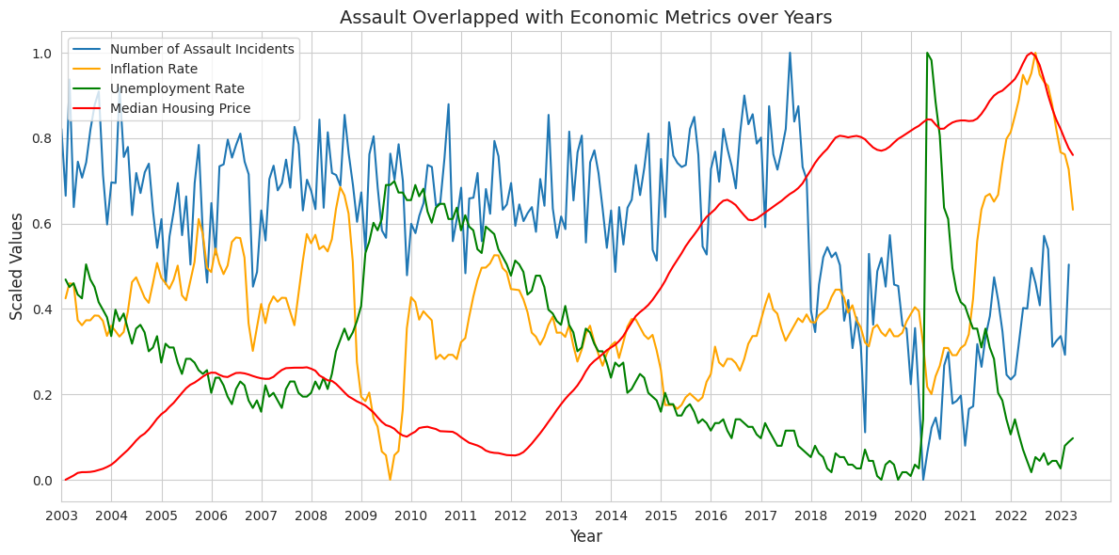
Hypothesis: Assault rate trend doesn’t follow economic factors patterns. There was a noticeable drop at the end of 2017, two years before the pandemic, which requires further exploration with additional data.

Slide 41
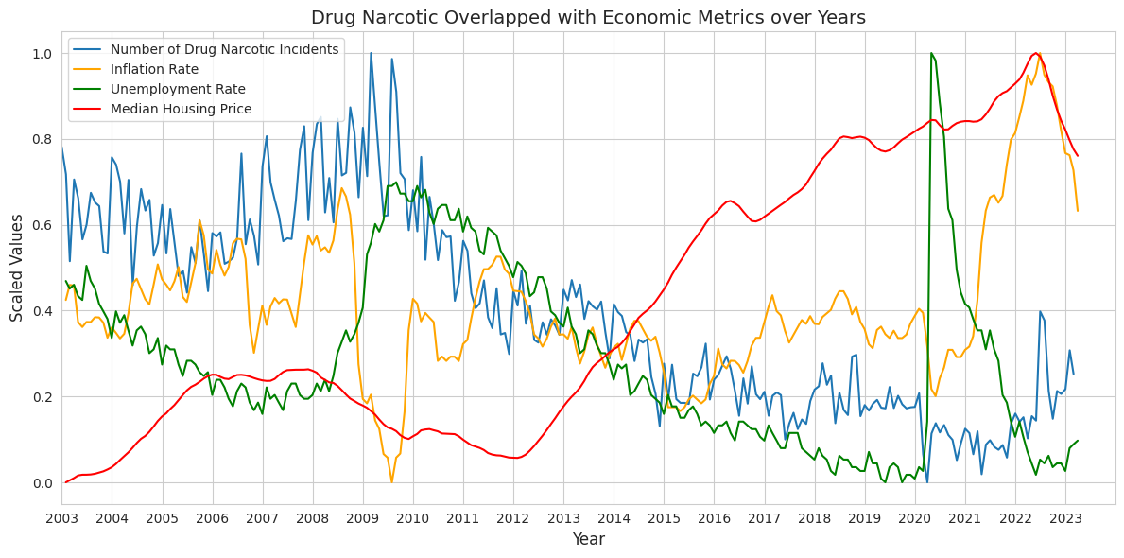
Hypothesis: Drug Narcotic rate trend follows the Unemployment Rate pattern => individuals tend to use drugs while not having stable jobs, and on the opposite - occupied individuals are less involved in drugs.

Slide 42
Proposition 47

Slide 43
Proposition 47
Proposition 47 (Prop 47) was a ballot measure passed by California voters on November 5, 2014.
Help ease prison crowding
The law made some non-violent property crimes, where the value does not exceed $950, into misdemeanors.
Also includes other crimes such as:
Possession of a Controlled Substance
Possession of Stolen Property
Bad Checks
Misdemeanor:
$1000 fine
Jail term of 1 year or less

Slide 44
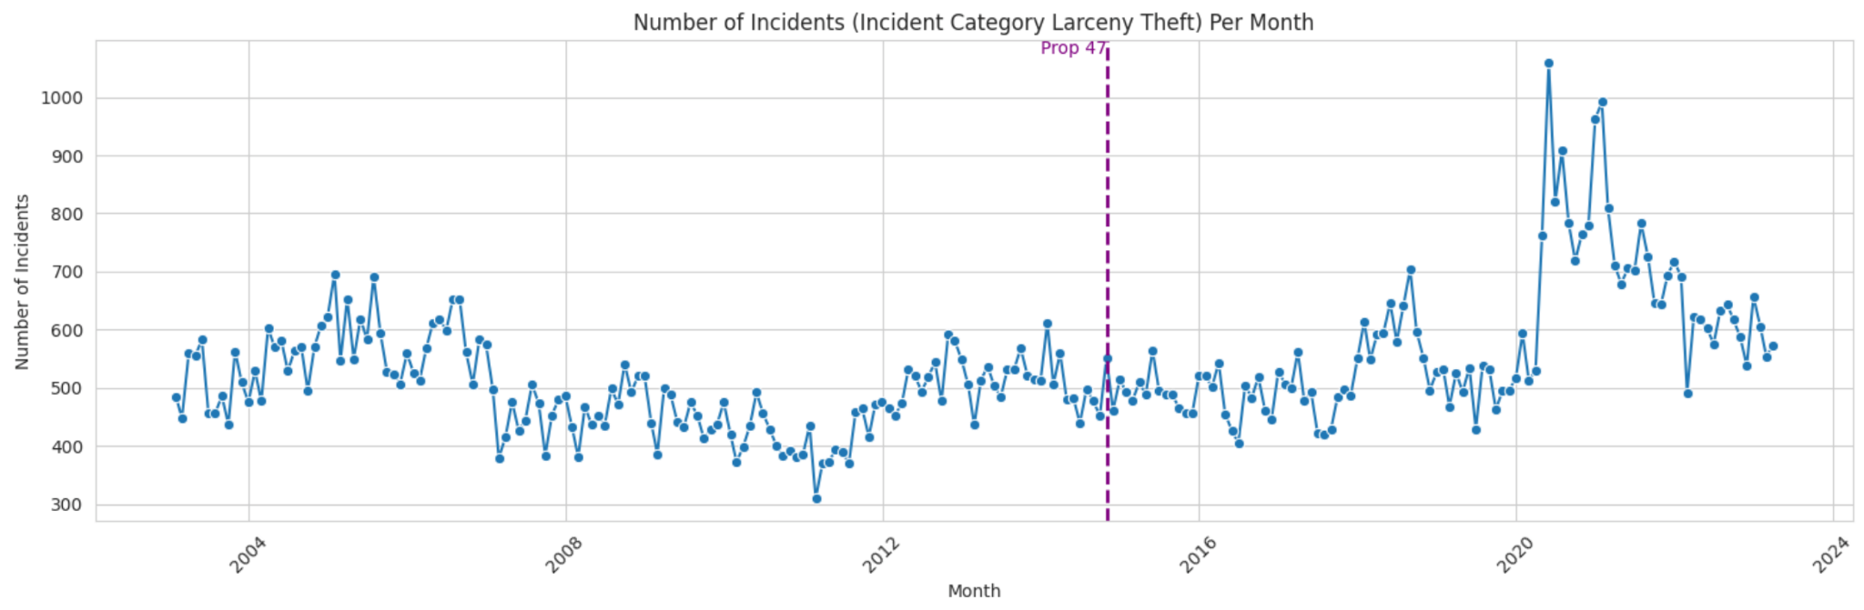
California Proposition 47 impact
Prop 47, passed in November 2014, did not significantly increase larceny theft in the years immediately following.
Hypothesis: it may have contributed to the rise in theft during 2020-2022. After this peak, larceny rates in San Francisco returned to around pre-2020 levels (but still fairly high).

Slide 45
Conclusion / Community Contribution
Another look at Prop 47:
Made it easier for people to shoplift without any consequences
If they have stolen thousands of dollars before hand and gets caught once
Only has to pay one $1000 fine
Very lucrative for criminals who take use of Prop 47
What if we stationed more police and patrol routes?
Even though police are stationed near tourist spots, shoplifting will still happen because the legal system made it very easy to do so with diminished consequences.

Slide 46
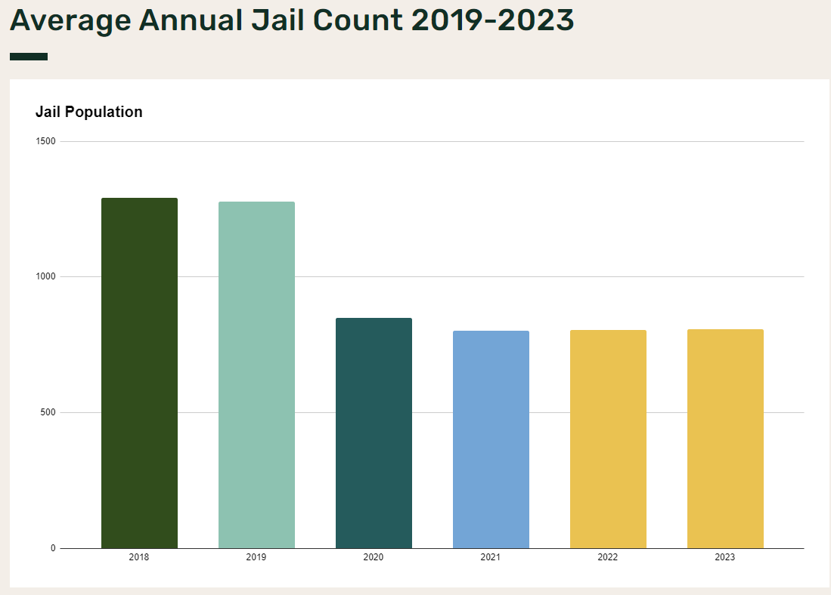
Conclusion / Community Contribution
The legal system MUST be changed.
IDEA: Use negative reinforcement such as incarceration
Prop 47 must be revised or looked at again
Prop 47 initially introduced for prison crowding.
If prisons are not full then why not incarcerate shoplifters?
Will discourage other shoplifters
If prisons are full?
Spend tax money on prison expansion
Otherwise San Francisco will be rampant with crime everywhere and authorities could not enforce anything.
Image Reference: https://www.sfsheriff.com/services/jail-services/current-and-historical-jail-data/jail-data-2019-2023

Slide 47
Conclusion / Community Contribution
Data exploration and mining into the nature of incidents in the city of San Francisco, along with any correlations to various economic factors (unemployment rates, inflation rates, and median housing prices).
Extensive steps of data preparation, cleaning, and merging
Uncovered a number of insights into crime incidents of the city of San Francisco (Ex: notorious Prop 47 did not in fact lead to substantial increases to larceny in the years following its enactment).
Hope that the insights that we produced may be helpful to multiple groups.
Policymakers in other states may feel more confident that enacting laws similar to Prop 47 will not lead to a substantial increase in crime on its own.

Slide 48
Conclusion / Community Contribution
The government may expect sharp increases in incidents when inflation rises sharply and may plan accordingly.
Allowing for better preparedness in the situation to reduce or mitigate damage done by crime
Law enforcement may use this data to better plan patrol routes
Hopefully less crimes will happen under the watch of authorities
Tourists visiting San Francisco may use the insights to plan for a safer stay
Increase foot traffic into the city and country
Increase spending and boosts the economy

Slide 49
Conclusion / Community Contribution
Realtors may use the fact that a neighborhood has low crime incidents as a selling point to potential buyers.
Safer neighborhoods will attract more people to live in the area
More people can attract more jobs, reducing unemployment rates
Lawmakers need to go back to the drawing board again to enforce the law given the data
Possibly apply Incarceration as a form of negative reinforcement
Discouraging other shoplifters and other thieves to do so (larceny theft is the largest incident category)
Overall, we feel that the insights gathered from this data may be beneficial to numerous groups of people, including citizens and policymakers in SF and other places

Slide 50
References
A. Mukherjee, S. De, S. Bhattacharyya and J. Platos, "Chicago Crime Data Analysis
Using PIG in Hadoop," 2018 Fourth International Conference on Research in
Computational Intelligence and Communication Networks (ICRCICN), Kolkata, India, 2018, pp. 242-247, doi: 10.1109/ICRCICN.2018.8718725.
Delouya, S. (2023, August 30). It’s not just crime: What’s really going on with San Francisco’s shrinking retail district | CNN business. CNN. https://www.cnn.com/2023/08/30/business/san-francisco-union-square-retail-closures/index.html
Ha, Jongrim, M. Ayhan Kose, and Franziska Ohnsorge (2021). "One-Stop Source: A Global Database of Inflation." Policy Research Working Paper 9737, World Bank, Washington DC
Housing Data - Zillow Research. (n.d.). https://www.zillow.com/research/data/
Kerr, E., & Lankford, K. (2023, August 8). Inflation calculator: See how much inflation is costing you - U.S. news. https://money.usnews.com/money/personal-finance/family-finance/articles/inflation-calculator-see-how-much-inflation-is-costing-you
Monika and A. Bhat, "An analysis of Crime data under Apache Pig on Big Data," 2019
Third International conference on I-SMAC (IoT in Social, Mobile, Analytics and
Cloud) (I-SMAC), Palladam, India, 2019, pp. 330-335, doi: 10.1109/I-SMAC47947.2019.9032565.
Police Department Incident Reports: Historical 2003 to May 2018: DataSF: City and county of San Francisco. DataSF. (2021, March 25). https://data.sfgov.org/Public-Safety/Police-Department-Incident-Reports-Historical-2003/tmnf-yvry
Police Department Incident Reports: 2018 to present: DataSF: City and county of San Francisco. DataSF. (2023, October 29). https://data.sfgov.org/Public-Safety/Police-Department-Incident-Reports-2018-to-Present/wg3w-h783
S. S. Wijaya, M. Anugerah Ayu and T. Mantoro, "Providing Real-time Crime Statistics in Indonesia Using Data Mining Approach," 2019 5th International Conference on Computing Engineering and Design (ICCED), Singapore, 2019, pp. 1-5, doi: 10.1109/ICCED46541.2019.9161096.
Unemployment rate in San Francisco County/city, CA. FRED. (2023, September 27). https://fred.stlouisfed.org/series/CASANF0URN

Slide 51
Thank You!
Questions?

